Slide 1
Unit 6 : Data Mining Approaches and Methods
Lecturer : Bijay Mishra

Slide 2
Types of Data Mining Models
Predictive Model
(a)Classification -Data is mapped into predefined groups or classes. Also termed as supervised learning as classes are established prior to examination of data.
(b) Regression- Mapping of data item into known type of functions. These may be linear, logistic functions etc.
(c) Time Series Analysis- Value of an attribute are examined at evenly spaced times, as it varies with time.
(d) Prediction- It means fore telling future data states based on past and current data.
Descriptive Models
(a) Clustering- It is referred as unsupervised learning or segmentation/partitioning. In
clustering groups are not pre-defined.
(b) Summarization- Data is mapped into subsets with simple descriptions . Also termed as Characterization or generalization.
(c) Sequence Discovery- Sequential analysis or sequence discovery utilized to find out
sequential patterns in data. Similar to association but relationship is based on time.
(d) Association Rules- A model which identifies specific types of data associations.

Slide 3
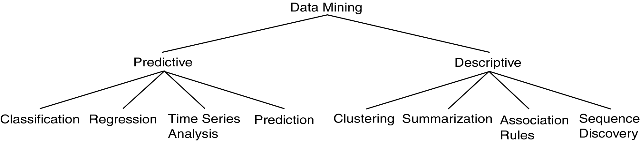
Descriptive vs. Predictive Data Mining
Descriptive Mining:
It describes concepts or task-relevant data sets in concise, summarative, informative, discriminative forms.
Predictive Mining:
It is based on data and analysis, constructs models for the database, and predicts the trend and properties of unknown data.

Slide 4
Supervised and Unsupervised learning
Supervised learning:
The network answer to each input pattern is directly compared with the desired answer and a feedback is given to the network to correct possible errors
Unsupervised learning:
The target answer is unknown. The network groups the input patterns of the training sets into clusters, based on correlation and similarities.

Slide 5
Supervised
Bayesian Modeling
Decision Trees
Neural Networks
Unsupervised
One-way Clustering
Two-way Clustering
Type and number of classes are known in advance
Type and number of classes are NOT known in advance

Slide 6
Concept/Class Description
A concept typically refers to a collection of data such as frequent buyers, graduate students, and so on. As a data mining task, concept description is not a simple enumeration of the data. Instead, concept description generates descriptions for the characterization and comparison of the data. It is sometimes called class description, when the concept to be described refers to a class of objects.

Slide 7
Concept description is the most basic form of descriptive data mining. It describes a given set of task-relevant data in a concise and summarative manner, presenting interesting general properties of the data.
Data can be associated with classes or concepts. For example, in the AllElectronics store, classes of items for sale include computers and printers, and concepts of customers include bigSpenders and budgetSpenders. It can be useful to describe individual classes and concepts in summarized, concise, and yet precise terms. Such descriptions of a class or a concept are called class/concept descriptions.
These descriptions can be derived via
Data characterization, by summarizing the data of the class under study (often called the target class) in general terms, or
Data discrimination, by comparison of the target class with one or a set of comparative classes (often called the contrasting classes), or
both data characterization and discrimination.
The output of data characterization can be presented in various forms. Examples include pie charts, bar charts, curves, multidimensional data cubes, and multidimensional tables, including crosstabs. The resulting descriptions can also be presented as generalized relations or in rule form(called characteristic rules).

Slide 8
Data Characterization
Data Characterization:
A data mining system should be able to produce a description summarizing the characteristics of customers.
Example:
The characteristics of customers who spend more than $1000 a year at XYZ store. The result can be a general profile such as age, employment status or credit ratings.

Slide 9
Data Discrimination
Data Discrimination:
It is a comparison of the general features of targeting class data objects with the general features of objects from one or a set of contrasting classes. User can specify target and contrasting classes.
Example:
The user may like to compare the general features of software products whose sales increased by 10% in the last year with those whose sales decreased by about 30% in the same duration.

Slide 10
Concept Description vs. OLAP
Concept Description
can handle complex data types of the attributes and their aggregations
a more automated process
OLAP
restricted to a small number of dimension and measure types
user-controlled process

Slide 11
Data Generalization
1
2
3
Conceptual levels
4
5
Data generalization is a process that abstracts a large set of task-relevant data in a database from a relatively low conceptual level to higher conceptual levels.
Data generalization summarizes data by replacing relatively low-level values (such as numeric values for an attribute age) with higher-level concepts (such as young, middleaged, and senior).

Slide 12
Given the large amount of data stored in databases, it is useful to be able to describe concepts in concise and brief terms at generalized (rather than low) levels of abstraction. Allowing data sets to be generalized atmultiple levels of abstraction facilitates users in examining the general behavior of the data.
Data generalization approaches include data cube approach (OLAP Approach) and attribute oriented induction approach.

Slide 13
Data Cube Approach (without using Attribute Oriented-Induction)
It perform computations and store results in data cubes
Strength
An efficient implementation of data generalization
Computation of various kinds of measures
e.g., count( ), sum( ), average( ), max( )
Generalization and specialization can be performed on a data cube by roll-up and drill-down
Limitations
handle only dimensions of simple nonnumeric data and measures of simple aggregated numeric values.
Lack of intelligent analysis, can’t tell which dimensions should be used and what levels should the generalization reach

Slide 14
Attribute-Oriented Induction
Proposed in 1989 (KDD ‘89 workshop)
Not confined to categorical data nor particular measures.
How it is done?
Collect the task-relevant data( initial relation) using a relational database query
Perform generalization by attribute removal or attribute generalization.
Apply aggregation by merging identical, generalized tuples and accumulating their respective counts.
Interactive presentation with users.

Slide 15
Classification and Prediction
Classification and prediction are two forms of data analysis that can be used to extract models describing important data classes or to predict future data trends. Such analysis can help provide us with a better understanding of the data at large.
Whereas classification predicts categorical (discrete, unordered) labels, prediction models continuous valued functions.
For example, we can build a classification model to categorize bank loan applications as either safe or risky, or a prediction model to predict the expenditures in dollars of potential customers on computer equipment given their income and occupation.

Slide 16
Prediction
Prediction is viewed as the construction and use of a model to assess the class of an unlabeled sample or to assess the value ranges of an attribute that a given sample is likely to have.
It is a statement or claim that a particular event will occur in the future in more certain terms than a forecast . It is similar to classification .It constructs a model to predict unknown or missing values. Prediction is the most prevalent grade level expectation on reasoning in state mathematics standards.

Slide 17
Generally it predicts a continuous value rather than categorical label. Numeric prediction predicts the continuous value. The most widely used approach for numeric prediction is regression.
Regression analysis is used to model the relationship between one or more independent or predictor variables and a dependent or response variable. In the context of Data Mining, predictor variables are attributes of interest describing the tuple.

Slide 18
Linear Regression
Regression is a statistical methodology developed by Sir Frances Galton in 1822-1911.Straight line regression analysis involves a response variable y and a single predictor variable x.
The simplest form of regression is
y = a + bx
Where y is response variable and x is single predictor variable y is a linear function of x. a and b are regression coefficients.
As the regression coefficients are also considered as weights, we may write the above equation as:
y = w+w1x
These coefficients are solved by the method of least squares, which estimates the best fitting straight line as the one that minimizes the error between the actual data and the estimate of the line.

Slide 19
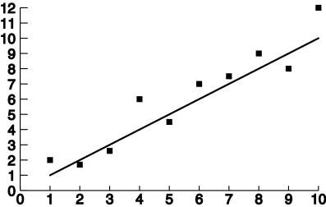
Linear Regression

Slide 20
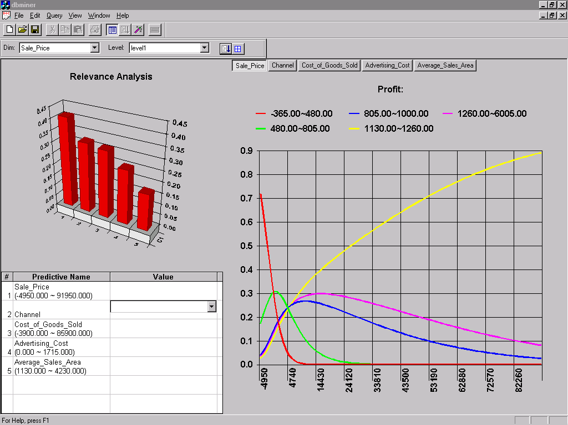
Prediction: Numerical Data

Slide 21
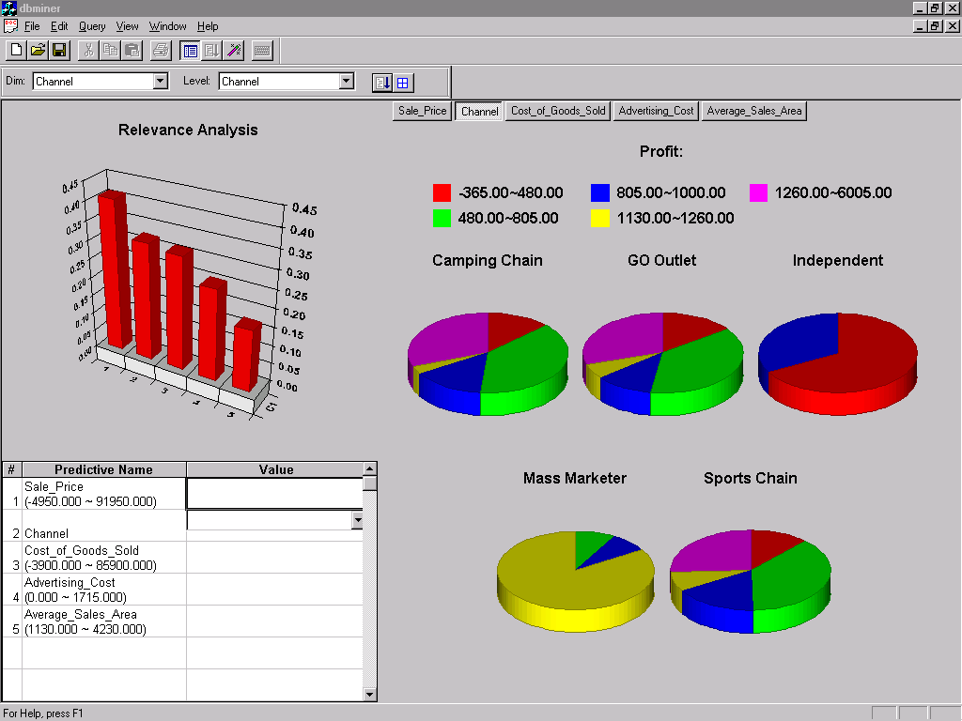
Prediction: Categorical Data

Slide 22
Classification
Classification can be described by a two step process given in appended block diagram:
Training
Data
Classification
Algorithm
Classification
Rules
Analyses Training Data
Learned Model
Or Classifier
Step 1
Also known as “supervised learning” as class labels are known. It is different than “Unsupervised learning” or clustering where class labels are not known. A model is built describing a predetermined set of data classes or concepts. The model is constructed by analyzing database tuples described by their attributes. Each tuple is assumed to belong to a predefined class and called as a class label attribute. Data tuples are also referred as Samples, Examples or Objects. Data tuples selected randomly form a training data set and are called training samples. The learning of the model is termed as” Supervised “ as it is told which class the training sample belongs. This is in contrast to Clustering which is termed unsupervised learning.

Slide 23
Step 2
Test data verifies the accuracy of Classification Rules
Test
Data
Classification
Rules
New
Data
Result
The model is used for classification. First the predictive accuracy of the model is estimated. If the accuracy is acceptable the model can be used to classify future tuples or objects for which class label is not known.

Slide 24
Classification is the process of finding a model (or function) that describes and distinguishes data classes or concepts, for the purpose of being able to use the model to predict the class of objects whose class label is unknown. The derived model is based on the analysis of a set of training data (i.e., data objects whose class label is known).
“How is the derived model presented?” The derived model may be represented in various forms, such as classification (IF-THEN) rules, decision trees, mathematical formulae, or neural networks.

Slide 25
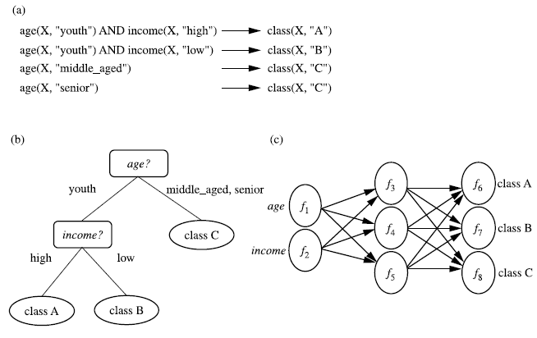
Figure : A classification model can be represented in various forms, such as (a) IF-THEN rules, (b) a decision tree, or a (c) neural network.

Slide 26
Classification : Example of Grading
x
<90
>=90
If x >= 90 then grade =A.
If 80<=x<90 then grade =B.
If 70<=x<80 then grade =C.
If 60<=x<70 then grade =D.
If x<50 then grade =F.
x
A
<80
>=80
x
B
<70
>=70
x
C
<50
>=60
F
D

Slide 27
How does classification work?
Data classification is a two-step process:
Model construction
Training data are analyzed by a classification algorithm. A classifier is built describing a predetermined set of data classes or concepts. Also called as training phase or learning stage.
Model usage
Test data are used to estimate the accuracy of the classification rules. If the accuracy is considered acceptable, the rules can be applied to the classification of new data tuples.

Slide 28
Model Construction
Classification
Algorithms
Training
Data
Classifier
(Model)
IF rank = ‘professor’
OR years > 6
THEN tenured = ‘yes’

Slide 29
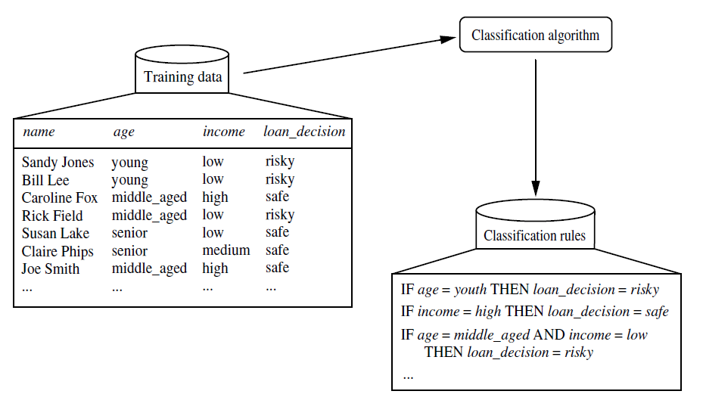
Figure: Learning
Here, the class label attribute is loan decision, and the learned model or classifier is
represented in the form of classification rules.

Slide 30
Model Usage
Classifier
Testing
Data
Unseen Data
(Jeff, Professor, 4)
Tenured?

Slide 31
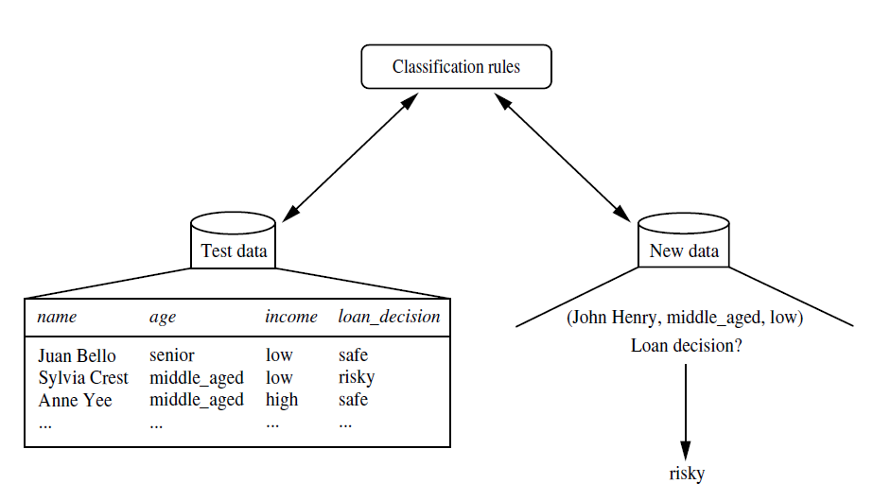
Figure: Classification

Slide 32
Examples of Classification Algorithms
Decision Trees
Neural Networks
Bayesian Networks

Slide 33
Issues regarding classification and prediction
Issues (1): Data Preparation
Data cleaning
Preprocess data in order to reduce noise and handle missing values
Relevance analysis (feature selection)
Remove the irrelevant or redundant attributes
Data transformation
Generalize and/or normalize data
Issues (2): Evaluating Classification Methods
Predictive accuracy
Speed and scalability
time to construct the model
time to use the model
Robustness
handling noise and missing values
Scalability
efficiency in disk-resident databases
Interpretability
understanding and insight provided by the model
Goodness of rules
decision tree size
compactness of classification rules

Slide 34
Decision Trees
A decision tree is a predictive model that as its name implies can be viewed as a tree. Specifically each branch of the tree is a classification question and the leaves are partitions of data set with their classification.
A decision tree makes a prediction on the basis of a series of decisions. The decision trees are being built on historical data and are a part of the supervised learning. The machine learning technique for inducting a decision tree from data is called decision tree learning.
Internal node denotes a test on an attribute
Branch represents an outcome of the test
Leaf nodes represent class labels or class distribution

Slide 35
In data mining, trees have three more descriptive categories/names:
Classification tree analysis - when the predicted outcome is the class to which the data belongs.
Regression tree analysis - when the predicted outcome can be considered a real number (e.g. the price of a house, or a patient’s length of stay in a hospital).
Classification And Regression Tree (CART) analysis - when both of the above procedures are referred.
Decision tree generation consists of two phases
Tree construction
At start, all the training examples are at the root
Partition examples recursively based on selected attributes
Tree pruning
Identify and remove branches that reflect noise or outliers

Slide 36
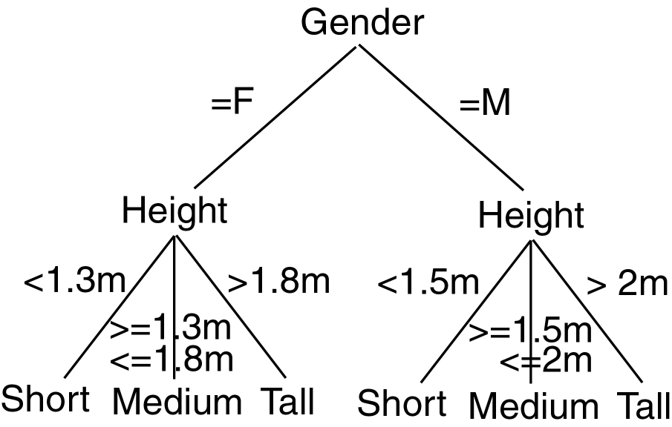
Decision Tree Example

Slide 37
Decision Tree: Example
Day Outlook Temperature Humidity Wind Play Tennis
1 Sunny Hot High Weak No
2 Sunny Hot High Strong No
3 Overcast Hot High Weak Yes
4 Rain Mild High Weak Yes
5 Rain Cool Normal Weak Yes
6 Rain Cool Normal Strong No
7 Overcast Cool Normal Strong Yes
8 Sunny Mild High Weak No
9 Sunny Cool Normal Weak Yes
10 Rain Mild Normal Weak Yes
11 Sunny Mild Normal Strong Yes
12 Overcast Mild High Strong Yes
13 Overcast Hot Normal Weak Yes
14 Rain Mild High Strong No
Outlook
Sunny
Rain
Overcast
Humidity
Yes
Wind
High
Normal
Strong
Weak
No
Yes
No
Yes
Attributes = {Outlook, Temperature, Humidity, Wind}
Play Tennis = {yes, no}

Slide 38
Decision Tree Induction
Basic algorithm (a greedy algorithm)
Tree is constructed in a top-down recursive divide-and-conquer manner
At start, all the training examples are at the root
Examples are partitioned recursively to maximize purity
Conditions for stopping partitioning
All samples belong to the same class
Leaf node smaller than a specified threshold
Tradeoff between complexity and generalizability
Predictions for new data:
Classification by majority voting is employed for classifying all members of the leaf
Probability based on training data that ended up in that leaf.
Class Probability estimates can be used also

Slide 39
Algorithm for building Decision Trees
Decision trees are a popular structure for supervised learning. They are constructed using attributes best able to differentiate the concepts to be learned.
A decision tree is built by initially selecting a subset of instances from a training set. This subset is then used by the algorithm to construct a decision tree. The remaining training set instances test the accuracy of the constructed tree.

Slide 40
If the decision tree classified the instances correctly, the procedure terminates.
If an instance is incorrectly classified, the instance is added to the selected subset of training instances and a new tree is constructed.
This process continues until a tree that correctly classify all non-selected instances is created or the decision tree is built from the entire training set.

Slide 41
|-------- Data Preparation Stage --------|------- Tree Building Stage -------|--- Prediction Stage ---|

Slide 42
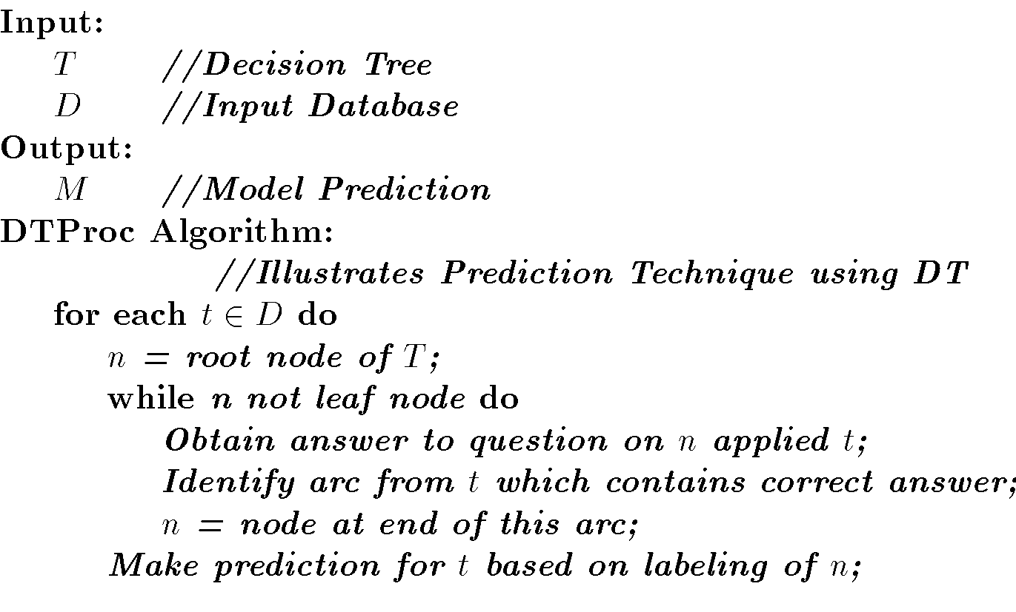
Decision Tree Algorithm

Slide 43
Decision Tree Pseudocode
node = tree-design(Data = {X,C})
For i = 1 to d
quality_variable(i) = quality_score(X_{i}, C)
end
node = {X_split, Threshold } for max{quality_variable}
{Data_right, Data_left} = split(Data, X_split, Threshold)
if node == leaf?
return(node)
else
node_right = tree-design(Data_right)
node_left = tree-design(Data_left)
end
end

Slide 44
Basic algorithm for inducing a decision tree
Algorithm: Generate_decision_tree. Generate a decision tree from the given training data.
Input: The training samples, represented by discrete-valued attributes; the set of candidate attributes, attribute-list;
Output: A decision tree

Slide 45
Begin
Partition (S)
If (all records in S are of the same class or only 1 record found in S)
then return;
For each attribute Ai do
evaluate splits on attribute Ai;
Use best split found to partition S into S1 and S2 to grow a tree with two Partition (S1) and Partition (S2);
Repeat partitioning for Partition (S1) and (S2) until it meets tree stop growing criteria;
End;

Slide 46
Decision Tree Algorithms & their main Issues
Tree Structure - Selection of a tree structure like Balanced tree for improving performance.
Training Data - Structure of a tree depends on the training data. Selecting adequate data prevents either the tree to overfit and on the other hand good enough to work on a general data
Stopping Criteria - Construction of a tree stops on a Stopping criteria. It is essential to achieve a balance between too early or late to create a tree with right level.
Pruning - After constructing a tree, modify it to remove duplication or subtrees.
Splitting - Selection of the best splitting attribute and size of the training set are important factors in creating a decision tree algorithm. For example, Splitting attributes in the case of students may be gender, marks scored and electives chosen. The order in which splitting attributes are chosen are important for avoiding redundancy and unnecessary comparisons at different levels.

Slide 47
Decision Tree Learning Algorithm - ID3
ID3 (Iterative Dichotomiser) is a simple decision tree learning algorithm developed by Ross Quinlan (1983). ID3 follow non-backtracking approach in which decision trees are constructed in a top-down recursive “divide and conquer” manner to test each attribute at every tree node. This approach starts with a training set of tuples and their associated class labels. Training set is recursively partitioned into smaller subsets as the tree is being built.

Slide 48
ID3 Algorithm:
1.create a node N;
2. if tuples in D are all of the same class C then
3. return N as a leaf node labeled with the class C;
4. if attribute_list is empty then
5. return N as a leaf node labled with the majority class in D;
6.apply Attribute_selection_method(D, attribute_list) to find the "best"splitting_criterion;
label node N with with splitting_criterion;
7. if splitting_attribute is discrete-valued and
multiway splits allowed then //not restricted to binary trees
attribute_list (arrow mark) attribute _ list - splitting_attribute;
8. for each outcome j of splitting_criterion
9. let (symbol)be the set of data tuples in D satisfying outcome j; // partition
10.if (symbol) is empty then
attach a leaf labeled with the majority class in D to node N;
11. else attach the node returned by
Generate_decision_tree(symbol,attribute_list)to node N;
endfor
return N;

Slide 49
Explanation of Algorithm:
The above algorithm has three parameters D, attribute_list and attribute_selection_method. D is data partition. It is a set of training tuples and their associated class labels. Attribute_list contains a list of attributes describing the tuples.
Now tree starts as a single node N. It represents the training tuples in D. If the tuples in D are all of the same class then node N is considered as leaf. It is labeled with that class. It is occurring in step 2 and 3. Step 4 and 5 are terminating conditions. IF this condition does not follow then algorithm calls Attribute_selection_method to detemine the spilitting criterion. This criterion determines the best way to partition the tuples in D into individual classes(step 6). Step 7 serves as a test at the node. In steps 10 and 11, tuples in D are partitioned.

Slide 50
Advantages of using ID3
Understandable prediction rules are created from the training data.
Builds the fastest tree.
Builds a short tree.
Only need to test enough attributes until all data is classified.
Finding leaf nodes enables test data to be pruned, reducing number of tests.
Whole dataset is searched to create tree.

Slide 51
Disadvantages of using ID3
Data may be over-fitted or over-classified, if a small sample is tested.
Only one attribute at a time is tested for making a decision.
Classifying continuous data may be computationally expensive, as many trees must be generated to see where to break the continuum.

Slide 52
Pros and Cons of Decision Tree
Pros
no distributional assumptions
can handle real and nominal inputs
speed and scalability
robustness to outliers and missing values
interpretability
compactness of classification rules
They are easy to use.
Generated rules are easy to understand .
Amenable to scaling and the database size.
Cons
several tuning parameters to set with little guidance
decision boundary is non-continuous
Cannot handle continuous data.
Incapable of handling many problems which cannot be divided into attribute domains.
Can lead to over-fitting as the trees are constructed from training data.

Slide 53
Neural Networks
Neural Network is a set of connected INPUT/OUTPUT UNITS, where each connection has a WEIGHT associated with it. It is a case of SUPERVISED, INDUCTIVE or CLASSIFICATION learning.
Neural Network learns by adjusting the weights so as to be able to correctly classify the training data and hence, after testing phase, to classify unknown data. Neural Network needs long time for training. Neural Network has a high tolerance to noisy and incomplete data.

Slide 54
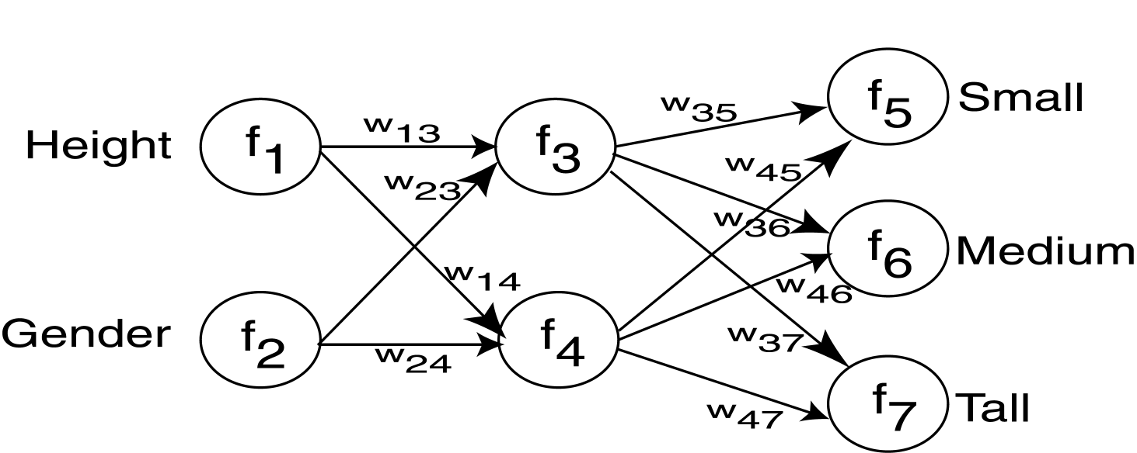
A Neural Network (NN) is a directed graph F=<V,A> with vertices V={1,2,…,n} and arcs A={<i,j>|1<=i,j<=n}, with the following restrictions:
V is partitioned into a set of input nodes, V_{I}, hidden nodes, V_{H}, and output nodes, V_{O}.
The vertices are also partitioned into layers
Any arc <i,j> must have node i in layer h-1 and node j in layer h.
Arc <i,j> is labeled with a numeric value w_{ij}.
Node i is labeled with a function f_{i}.

Slide 55
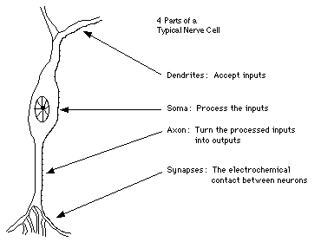
Similarity with Biological Network
Fundamental processing element of a neural network is a neuron
A human brain has 100 billion neurons
An ant brain has 250,000 neurons

Slide 56
A Neuron (= a Perceptron)
-
μ_{k}
x₀
w₀
x₁
w₁
∑
f
output y
x_{n}
w_{n}
Input
vector x
weight
vector w
weighted
sum
Activation
function
The n-dimensional input vector x is mapped into variable y by means of the scalar product and a nonlinear function mapping

Slide 57
Network Training
The ultimate objective of training is to obtain a set of weights that makes almost all the tuples in the training data classified correctly.
Steps
Initialize weights with random values
Feed the input tuples into the network one by one
For each unit
Compute the net input to the unit as a linear combination of all the inputs to the unit
Compute the output value using the activation function
Compute the error
Update the weights and the bias

Slide 58
Backpropagation
Backpropagation is a neural network learning algorithm which gained repute in the 1980s.
Backpropagation learns by iteratively processing a data set of training tuples, comparing the network’s prediction for each tuple with the actual known target value.
The target value may be the known class label of the training tuple (for classification problems) or a continuous value (for prediction).
For each training tuple, the weights are modified so as to minimize the mean squared error between the network’s prediction and the actual target value.

Slide 59
These modifications are made in the “backwards” direction, that is, from the output layer, through each hidden layer down to the first hidden layer (hence the name backpropagation).
Although it is not guaranteed, in general the weights will eventually converge, and the learning process stops.
Steps in Backpropagation:
Initialize weights (to small random numbers) and biases in the network
Propagate the inputs forward (by applying activation function)
Backpropagate the error (by updating weights and biases)
Terminating condition (when error is very small, etc.)

Slide 60
Perceptron
y1
y2
yp-1
yp
...
1
2
p-1
p
wp-1,1
w1,1
w1,n
wp,1
...
...
...
w2,1
w1,2
w1,n-1
wp,n
...
x1
x2
xn-1
xn

Slide 61
Multi-Layer Perceptron
Output vector
Output nodes
Hidden nodes
w_{ij}
Input nodes
Input vector: x_{i}

Slide 62
How A Multi-Layer Neural Network Works?
The inputs to the network correspond to the attributes measured for each training tuple
Inputs are fed simultaneously into the units making up the input layer
They are then weighted and fed simultaneously to a hidden layer
The number of hidden layers is arbitrary, although usually only one
The weighted outputs of the last hidden layer are input to units making up the output layer, which emits the network's prediction
The network is feed-forward in that none of the weights cycles back to an input unit or to an output unit of a previous layer
From a statistical point of view, networks perform nonlinear regression: Given enough hidden units and enough training samples, they can closely approximate any function

Slide 63
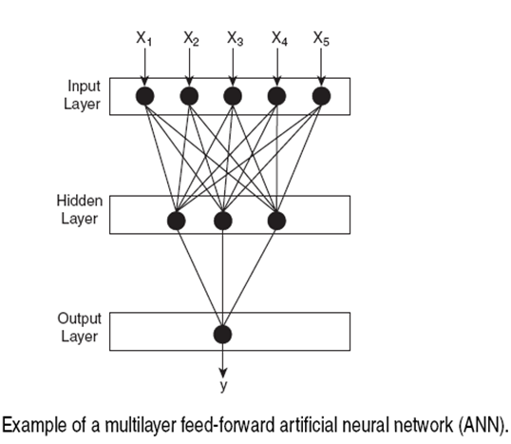

Slide 64
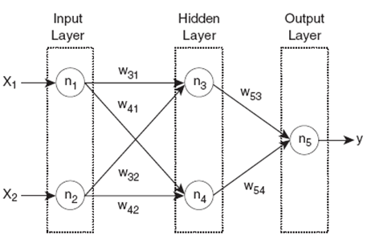


Slide 65
Advantages of Neural Network
prediction accuracy is generally high
robust, works when training examples contain errors
output may be discrete, real-valued, or a vector of several discrete or real-valued attributes
fast evaluation of the learned target function
High tolerance to noisy data
Ability to classify untrained patterns
Well-suited for continuous-valued inputs and outputs
Successful on a wide array of real-world data
Algorithms are inherently parallel
Techniques have recently been developed for the extraction of rules from trained neural networks
Disadvantages of Neural Network
long training time
difficult to understand the learned function (weights)
not easy to incorporate domain knowledge
Require a number of parameters typically best determined empirically, e.g., the network topology or ``structure."
Poor interpretability: Difficult to interpret the symbolic meaning behind the learned weights and of ``hidden units" in the network

Slide 66
Association Rule
Proposed by Agrawal et al in 1993.
It is an important data mining model studied extensively by the database and data mining community.
Assume all data are categorical.
No good algorithm for numeric data.
Initially used for Market Basket Analysis to find how items purchased by customers are related.
Given a set of records each of which contain some number of items from a given collection;
Produce dependency rules which will predict occurrence of an item based on occurrences of other items.
Rules Discovered:
{Milk} --> {Coke}
{Diaper, Milk} --> {Beer}

Slide 67
Applications:
Basket data analysis, cross-marketing, catalog design, loss-leader analysis, clustering, classification, etc.
E.g., 98% of people who purchase tires and auto accessories also get automotive services done
Concepts:
An item: an item/article in a basket
I: the set of all items sold in the store
A transaction: items purchased in a basket; it may have TID (transaction ID)
A transactional dataset: A set of transactions
The model: rules
A transaction t contains X, a set of items (itemset) in I, if X ⊆ t.
An association rule is an implication of the form:
X → Y, where X, Y ⊂ I, and X ∩Y = ∅
An itemset is a set of items.
E.g., X = {milk, bread, cereal} is an itemset.
A k-itemset is an itemset with k items.
E.g., {milk, bread, cereal} is a 3-itemset

Slide 68
Rule Strength Measures
Support:
The rule holds with support sup in T (the transaction data set) if sup% of transactions contain X ∪ Y.
sup = Pr(X ∪ Y)
Confidence:
The rule holds in T with confidence conf if conf% of transactions that contain X also contain Y.
conf = Pr(Y | X)
An association rule is a pattern that states when X occurs, Y occurs with certain probability.

Slide 69
Support and Confidence
support of X in D is count(X)/|D|
For an association rule X⇒Y, we can calculate
support (X⇒Y) = support (XY)
confidence (X⇒Y) = support (XY)/support (X)
Relate Support (S) and Confidence (C) to Joint and Conditional probabilities
There could be exponentially many A-rules
Interesting association rules are (for now) those whose S and C are greater than minSup and minConf (some thresholds set by data miners)

Slide 70
Support and Confidence
Support count:
The support count of an itemset X, denoted by X.count, in a data set T is the number of transactions in T that contain X. Assume T has n transactions. Then,

Slide 71
Basic Concepts: Association Rules
Transaction-id | Items bought
10 | A, B, C
20 | A, C
30 | A, D
40 | B, E, F
Itemset X={x₁, …, x_{k}}
Find all the rules X→Y with min confidence and support
support, s, probability that a transaction contains X∪Y
confidence, c, conditional probability that a transaction having X also contains Y.
Customer
buys both
Customer
buys diaper
Let minimum support 50%, and minimum confidence 50%, we have
A → C (50%, 66.7%)
C → A (50%, 100%)
Customer
buys beer

Slide 72
Example
Data set D
Count, Support, Confidence:
Count(13)=2
|D| = 4
Support(13)=0.5
Support(3→2)=0.5
Confidence(3→2)=0.67
TID | Itemsets
T100 | 1 3 4
T200 | 2 3 5
T300 | 1 2 3 5
T400 | 2 5

Slide 73
Mining Association Rules: Example
Min. support 50%
Min. confidence 50%
Transaction-id | Items bought
10 | A, B, C
20 | A, C
30 | A, D
40 | B, E, F
Frequent pattern | Support
{A} | 75%
{B} | 50%
{C} | 50%
{A, C} | 50%
For rule A ⇒ C:
support = support({A}∪{C}) = 50%
confidence = support({A}∪{C})/support({A}) = 66.6%
The Apriori principle:
Any subset of a frequent itemset must be frequent

Slide 74
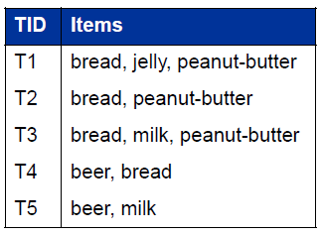
Example of Association Rule
Examples:
bread ⇒ peanut-butter
beer ⇒ bread
Frequent itemsets: Items that frequently appear together
I = {bread, peanut-butter}
I = {beer, bread}

Slide 75
Support count (σ): Frequency of occurrence of and itemset
σ ({bread, peanut-butter}) = 3
σ ({ beer, bread}) = 1
Support: Fraction of transactions that contain an itemset
s ({bread,peanut-butter}) = 3/5
s ({beer, bread}) = 1/5
Frequent itemset: An itemset whose support is greater than or equal to a minimum support threshold (minsup)

Slide 76


What’s an Interesting Rule?
An association rule is an implication of two itemsets:
X ⇒ Y
Many measures of interest. The two most used are:
Support (s): The occurring frequency of the rule, i.e., number of transactions that contain both X and Y
Confidence (c): The strength of the association, i e measures of how often items (X)

Slide 77
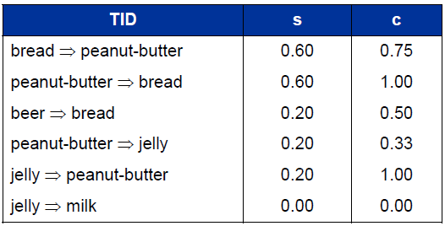

Slide 78
Mining Association Rules: What We Need to Know
Goal: Rules with high support/confidence
How to compute?
Support: Find sets of items that occur frequently
Confidence: Find frequency of subsets of supported itemsets
If we have all frequently occurring sets of items (frequent itemsets), we can compute support and confidence!

Slide 79
The Apriori Algorithm
Pseudo-code:
C_{k}: Candidate itemset of size k
L_{k} : frequent itemset of size k
L₁ = {frequent items};
for (k = 1; L_{k} !=∅; k++) do begin
C_{k+1} = candidates generated from L_{k};
for each transaction t in database do
increment the count of all candidates in C_{k+1} that are contained in t
L_{k+1} = candidates in C_{k+1} with min_support
end
return ∪_{k} L_{k};

Slide 80
A-Priori Algorithm (in nutshell)
Count
the items
All pairs
of items
from L₁
Count
the pairs
All
items
To be
explained
Filter
Construct
Filter
Construct
C₁
L₁
C₂
L₂
C₃
First
pass
Second
pass
Frequent
items
Frequent
pairs

Slide 81
The Apriori Algorithm—An Example
Database TDB
1-candidates
Freq 1-itemsets
C₁
Itemset | sup
{A} | 2
{B} | 3
{C} | 3
{D} | 1
{E} | 3
Tid | Items
10 | A, C, D
20 | B, C, E
30 | A, B, C, E
40 | B, E
L₁
Itemset | sup
{A} | 2
{B} | 3
{C} | 3
{E} | 3
1st scan
Min_sup=2
Frequency ≥ 50%, Confidence 100%:
A → C
B → E
BC → E
CE → B
BE → C
Freq 2-itemsets
Counting
2-candidates
L₂
Itemset | sup
{A, C} | 2
{B, C} | 2
{B, E} | 3
{C, E} | 2
C₂
Itemset | sup
{A, B} | 1
{A, C} | 2
{A, E} | 1
{B, C} | 2
{B, E} | 3
{C, E} | 2
C₂
Itemset
{A, B}
{A, C}
{A, E}
{B, C}
{B, E}
{C, E}
2nd scan
3-candidates
Freq 3-itemsets
Itemset
{B, C, E}
3rd scan
L₃
Itemset | sup
{B, C, E} | 2
C₃

Slide 82
Clustering and Cluster Analysis
A cluster is a collection of objects which are “similar” between them and are “dissimilar” to the objects belonging to other clusters.
Clustering is “the process of organizing objects into groups whose members are similar in some way”.
“Cluster Analysis is a set of methods for constructing a (hopefully) sensible and informative classification of an initially unclassified set of data, using the variable values observed on each individual.”
- B. S. Everitt (1998), “The Cambridge Dictionary of Statistics”

Slide 83
Applications of Cluster Analysis
Pattern Recognition
Spatial Data Analysis
Create thematic maps in GIS by clustering feature spaces
Detect spatial clusters or for other spatial mining tasks
Image Processing
Economic Science (especially market research)
WWW
Document classification
Cluster Weblog data to discover groups of similar access patterns

Slide 84
Applications of Cluster Analysis
Marketing: Help marketers discover distinct groups in their customer bases, and then use this knowledge to develop targeted marketing programs
Land use: Identification of areas of similar land use in an earth observation database
Insurance: Identifying groups of motor insurance policy holders with a high average claim cost
City-planning: Identifying groups of houses according to their house type, value, and geographical location
Earth-quake studies: Observed earth quake epicenters should be clustered along continent faults

Slide 85
Objectives of Cluster Analysis
Finding groups of objects such that the objects in a group will be similar (or related) to one another and different from (or unrelated to) the objects in other groups
Competing objectives
Intra-cluster distances are minimized
Inter-cluster distances are maximized

Slide 86
Types of Clusterings
Partitioning Clustering
A division data objects into non-overlapping subsets (clusters) such that each data object is in exactly one subset
Construct various partitions and then evaluate them by some criterion, e.g., minimizing the sum of square errors
Typical methods: k-means, k-medoids, CLARA (Clustering LARge Applications)
Hierarchical clustering
A set of nested clusters organized as a hierarchical tree
Create a hierarchical decomposition of the set of data (or objects) using some criterion
Typical methods: DiAna (Divisive Analysis), AgNes (Agglomerative Nesting), BIRCH (Balanced Iterative Reducing and Clustering using Hierarchies), ROCK (RObust Clustering using linKs), CAMELEON
Density-based Clustering
Based on connectivity and density functions
Typical methods: DBSACN (Density Based Spatial Clustering of Applications with Noise), OPTICS (Ordering Points To Identify the Clustering Structure), DenClue (DENsity-based CLUstEring )

Slide 87
Grid-based Clustering
based on a multiple-level granularity structure
Typical methods: STING (STatistical INformation Grid ), WaveCluster, CLIQUE (Clustering In QUEst)
Model-based Clustering
A model is hypothesized for each of the clusters and tries to find the best fit of that model to each other
Typical methods: EM (Expectation Maximization), SOM (Self-Organizing Map), COBWEB
Frequent pattern-based Clustering
Based on the analysis of frequent patterns
Typical methods: pCluster
User-guided or constraint-based Clustering
Clustering by considering user-specified or application-specific constraints
Typical methods: COD, constrained clustering

Slide 88
Partitioning Clustering
Original Points
A Partitional Clustering

Slide 89
Hierarchical Clustering
Use distance matrix as clustering criteria. This method does not require the number of clusters k as an input, but needs a termination condition
Step 0
Step 1
Step 2
Step 3
Step 4
agglomerative
(AGNES)
a
a b
b
a b c d e
c
c d e
d
d e
e
divisive
(DIANA)
Step 4
Step 3
Step 2
Step 1
Step 0

Slide 90
Agglomerative (bottom up)
start with 1 point (singleton)
recursively add two or more appropriate clusters
Stop when k number of clusters is achieved.
Divisive (top down)
Start with a big cluster
Recursively divide into smaller clusters
Stop when k number of clusters is achieved.

Slide 91
Dendrogram
Decompose data objects into a several levels of nested partitioning (tree of clusters), called a dendrogram.
A clustering of the data objects is obtained by cutting the dendrogram at the desired level, then each connected component forms a cluster.

Slide 92
Hierarchical Clustering
Dendrogram 1
Dendrogram 2

Slide 93
AGNES (Agglomerative Nesting)
Introduced in Kaufmann and Rousseeuw (1990)
Implemented in statistical analysis packages, e.g., Splus
Use the Single-Link method and the dissimilarity matrix.
Merge nodes that have the least dissimilarity
Go on in a non-descending fashion
Eventually all nodes belong to the same cluster

Slide 94
DIANA (Divisive Analysis)
Introduced in Kaufmann and Rousseeuw (1990)
Implemented in statistical analysis packages, e.g., Splus
Inverse order of AGNES
Eventually each node forms a cluster on its own

Slide 95
Hierarchical Clustering
Produces a set of nested clusters organized as a hierarchical tree
Can be visualized as a dendrogram
A tree like diagram that records the sequences of merges or splits

Slide 96
Strengths of Hierarchical Clustering
Do not have to assume any particular number of clusters
Any desired number of clusters can be obtained by ‘cutting’ the dendogram at the proper level
They may correspond to meaningful taxonomies
Example in biological sciences (e.g., animal kingdom, phylogeny reconstruction, …)

Slide 97
Hierarchical Clustering
Two main types of hierarchical clustering
Agglomerative (bottom up):
Start with the points as individual clusters
At each step, merge the closest pair of clusters until only one cluster (or k clusters) left
Divisive (top down):
Start with one, all-inclusive cluster
At each step, split a cluster until each cluster contains a point (or there are k clusters)

Slide 98
Agglomerative Clustering Algorithm
More popular hierarchical clustering technique
Basic algorithm
Compute the proximity matrix
Let each data point be a cluster
Repeat
Merge the two closest clusters
Update the proximity matrix
Until only a single cluster remains
Note:
Key operation is the computation of the proximity of two clusters
Different approaches to defining the distance between clusters distinguish the different algorithms

Slide 99
Starting Situation
Start with clusters of individual points and a proximity matrix
p1
p2
p3
p4
p5
. . .
p1
p2
p3
p4
p5
.
.
.
Proximity Matrix

Slide 100
Intermediate Situation
After some merging steps, we have some clusters
C1
C2
C3
C4
C5
C1
C2
C3
C3
C4
C4
C5
C1
Proximity Matrix
C2
C5

Slide 101
Intermediate Situation
We want to merge the two closest clusters (C2 and C5) and update the proximity matrix.
C1
C2
C3
C4
C5
C1
C3
C2
C4
C3
C4
C5
C1
Proximity Matrix
C2
C5

Slide 102
After Merging
The question is “How do we update the proximity matrix?”
C2 U C5
C1
C3
C4
C1
?
C3
C2 U C5
? ? ? ?
C4
C3
?
C4
?
C1
Proximity Matrix
C2 U C5

Slide 103
How to Define Inter-Cluster Similarity
p1
p2
p3
p4
p5
. . .
p1
Similarity?
p2
p3
p4
p5
MIN
MAX
Group Average
Distance Between Centroids
.
.
.
Proximity Matrix

Slide 104
How to Define Inter-Cluster Similarity
p1
p2
p3
p4
p5
. . .
p1
p2
p3
p4
p5
.
.
.
MIN
MAX
Group Average
Distance Between Centroids
Proximity Matrix

Slide 105
How to Define Inter-Cluster Similarity
p1
p2
p3
p4
p5
. . .
p1
p2
p3
p4
p5
MIN
MAX
Group Average
Distance Between Centroids
.
.
.
Proximity Matrix

Slide 106
How to Define Inter-Cluster Similarity
p1
p2
p3
p4
p5
. . .
p1
p2
p3
p4
p5
MIN
MAX
Group Average
Distance Between Centroids
.
.
.
Proximity Matrix

Slide 107
How to Define Inter-Cluster Similarity
p1
p2
p3
p4
p5
. . .
p1
×
×
p2
p3
p4
p5
MIN
MAX
Group Average
Distance Between Centroids
.
.
.
Proximity Matrix

Slide 108
Hierarchical Clustering: Problems and Limitations
Once a decision is made to combine two clusters, it cannot be undone
Different schemes have problems with one or more of the following:
Sensitivity to noise and outliers
Difficulty handling different sized clusters and convex shapes
Breaking large clusters (divisive)
Dendrogram correspond to a given hierarchical clustering is not unique, since for each merge one needs to specify which subtree should go on the left and which on the right
They impose structure on the data, instead of revealing structure in these data.

Slide 109
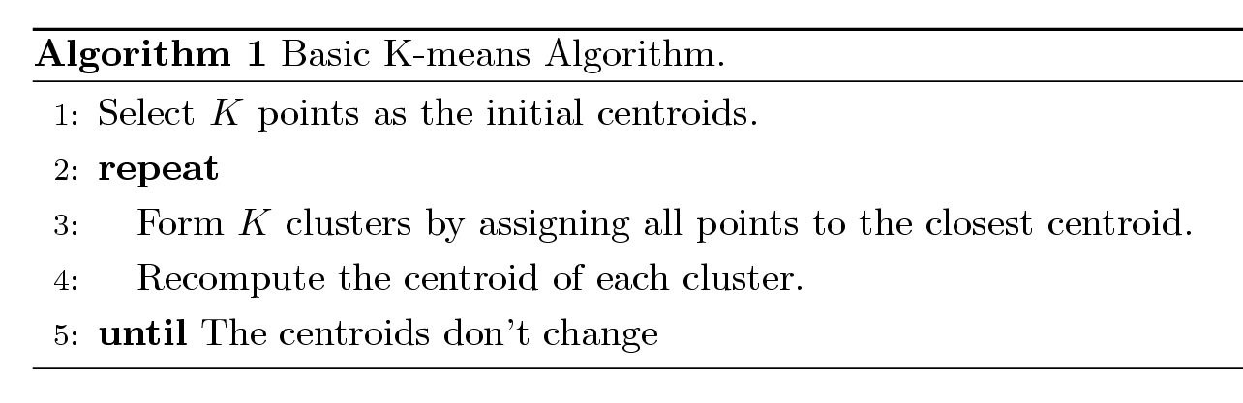
K-means Algorithm
Partitioning clustering approach
Each cluster is associated with a centroid (center point or mean point)
Each point is assigned to the cluster with the closest centroid
Number of clusters, K, must be specified
The basic algorithm is very simple:

Slide 110
The k-means partitioning algorithm.
Algorithm: k-means. The k-means algorithm for partitioning, where each cluster’s center is represented by the mean value of the objects in the cluster.
Input:
k: the number of clusters,
D: a data set containing n objects.
Output: A set of k clusters.
Method:
(1) arbitrarily choose k objects from D as the initial cluster centers;
(2) repeat
(3) (re)assign each object to the cluster to which the object is the most similar, based on the mean value of the objects in the cluster;
(4) update the cluster means, i.e., calculate the mean value of the objects for each cluster;
(5) until no change;

Slide 111
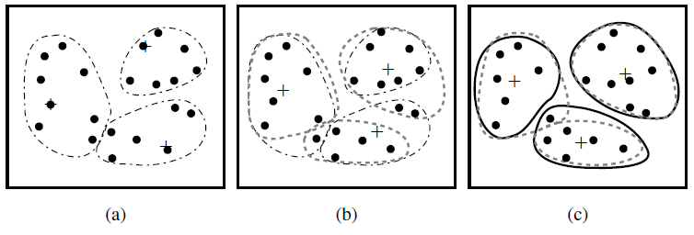
Figure: Clustering of a set of objects based on the k-means method. (The mean of each cluster is marked by a “+”.)

Slide 112
Example
10
10
9
9
8
8
7
7
6
6
5
5
4
Assign each objects to most similar center
Update the cluster means
4
3
3
2
2
1
1
0
0
0
1
2
3
4
5
6
7
8
9
10
0
1
2
3
4
5
6
7
8
9
10
reassign
reassign
K=2
Arbitrarily choose K object as initial cluster center
Update the cluster means

Slide 113
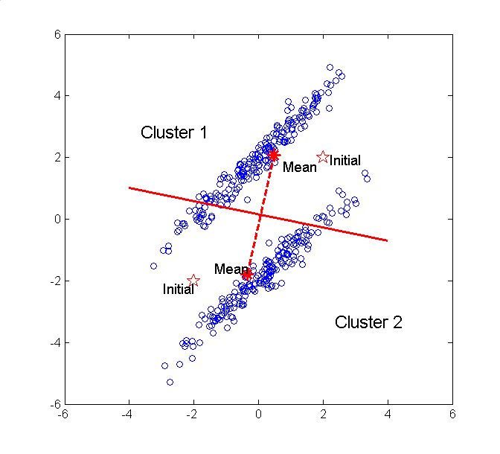

Slide 114
K-means Clustering – Details
Initial centroids are often chosen randomly.
Clusters produced vary from one run to another.
The centroid is (typically) the mean of the points in the cluster.
‘Closeness’ is measured mostly by Euclidean distance, cosine similarity, correlation, etc.
K-means will converge for common similarity measures mentioned above.
Most of the convergence happens in the first few iterations.
Often the stopping condition is changed to ‘Until relatively few points change clusters’
Complexity is O( n * K * I * d )
n = number of points, K = number of clusters, I = number of iterations, d = number of attributes
Typical choice

Slide 115
Issues and Limitations for K-means
How to choose initial centers?
How to choose K?
How to handle Outliers?
Clusters different in
Shape
Density
Size
Assumes clusters are spherical in vector space
Sensitive to coordinate changes

Slide 116
K-means Algorithm
Pros
Simple
Fast for low dimensional data
It can find pure sub clusters if large number of clusters is specified
Cons
K-Means cannot handle non-globular data of different sizes and densities
K-Means will not identify outliers
K-Means is restricted to data which has the notion of a center (centroid)
Applicable only when mean is defined, then what about categorical data?
Need to specify k, the number of clusters, in advance
Unable to handle noisy data and outliers
Not suitable to discover clusters with non-convex shapes

Slide 117
Outliers
What are outliers?
The set of objects are considerably dissimilar from the remainder of the data
Example: Sports: Michael Jordon, Randy Orton, Sachin Tendulkar ...
Applications:
Credit card fraud detection
Telecom fraud detection
Customer segmentation
Medical analysis
Outlier detection and analysis are very useful for fraud detection, etc. and can be performed by statistical, distance-based or deviation-based approaches

Slide 118
How to handle Outliers?
The k-means algorithm is sensitive to outliers !
Since an object with an extremely large value may substantially distort the distribution of the data.
K-Medoids: Instead of taking the mean value of the object in a cluster as a reference point, medoids can be used, which is the most centrally located object in a cluster.
10
10
9
9
8
8
7
7
6
6
5
5
4
4
3
3
2
2
1
1
0
0
1
2
3
4
5
6
7
8
9
10
0
0
1
2
3
4
5
6
7
8
9
10

Slide 119
Example:
Use in finding Fraudulent usage of credit cards. Outlier Analysis may uncover Fraudulent usage of credit cards by detecting purchases of extremely large amounts for a given account number in comparison to regular charges incurred by the same account. Outlier values may also be detected with respect to the location and type of purchase or the purchase frequency.

Slide 120
The K-Medoids Clustering Method
Find representative objects, called medoids, in clusters
PAM (Partitioning Around Medoids, 1987)
starts from an initial set of medoids and iteratively replaces one of the medoids by one of the non-medoids if it improves the total distance of the resulting clustering
PAM works effectively for small data sets, but does not scale well for large data sets
CLARA (Kaufmann & Rousseeuw, 1990)
CLARANS (Ng & Han, 1994): Randomized sampling
Focusing + spatial data structure (Ester et al., 1995)

Slide 121
A Typical K-Medoids Algorithm (PAM)
Total Cost = 20
10
9
8
Arbitrary choose k object as initial medoids
Assign each remaining object to nearest medoids
7
6
5
4
3
2
1
0
0
1
2
3
4
5
6
7
8
9
10
K=2
Randomly select a nonmedoid object,O_{ramdom}
Do loop
Until no change
Total Cost = 26
10
Compute total cost of swapping
10
Swapping O and O_{ramdom}
If quality is improved.
9
9
8
8
7
7
6
6
5
5
4
4
3
3
2
2
1
1
0
0
1
2
3
4
5
6
7
8
9
10
0
0
1
2
3
4
5
6
7
8
9
10

Slide 122
PAM (Partitioning Around Medoids)
PAM (Kaufman and Rousseeuw, 1987), built in Splus
Use real object to represent the cluster
Select k representative objects arbitrarily
For each pair of non-selected object h and selected object i, calculate the total swapping cost TC_{ih}
For each pair of i and h,
If TC_{ih} < 0, i is replaced by h
Then assign each non-selected object to the most similar representative object
repeat steps 2-3 until there is no change

Slide 123
PAM Clustering: Total swapping cost TC_{ih}=∑_{j}C_{jih}
t
j
t
j
i
h
h
i
h
j
i
i
t
h
j
t

Slide 124
Example of K-medoids
Given the two medoids that are initially chosen are A and B. Based on the following table and randomly placing items when distances are identical to the two medoids, we obtain the clusters {A, C, D} and {B, E}. The three non-medoids {C, D, E} are examined to see which should be used to replace A or B. We have six costs to determine: TC_{AC} (the cost change by replacing medoid A with medoid C), TC_{AD}, TC_{AE}, TC_{BC}, TC_{BD} and TC_{BE}.
TC_{AC}=C_{AAC}+C_{BAC}+C_{CAC}+C_{DAC}+C_{EAC} = 1 + 0 – 2 – 1 + 0 = -2
Where C_{AAC} = the cost change of object A after replacing medoid A with medoid C

Slide 126
Cost calculations for example
The diagram illustrates the calculation of these six costs. We see that the minimum cost is 2 and that there are several ways to reduce this cost. Arbitrarily choosing the first swap, we get C and B as the new medoids with the clusters being {C, D} and {B, A, E}

Slide 127
An example
Initial five objects A, B, C, D, E, two clusters (A, C, D), (B, E), and centers {A, B}.
Evaluate swap enter A to center C.
Consider the new cost (new centers {B, C})
TC_{AC} = C_{AAC} + C_{BAC} + C_{CAC} + C_{DAC} + C_{EAC}
C_{AAC} = C_{AB} - C_{AA} = 1 – 0 = 1
C_{BAC} = C_{BB} - C_{BB} = 0 – 0 = 0
C_{CAC} = C_{CC} - C_{CA} = 0 – 2 = -2
C_{DAC} = C_{DC} - C_{DA} = 1 – 2 = -1
C_{EAC} = C_{EB} - C_{EB} = 3 – 3 = 0
As a result, TC_{AC} = 1 + 0 – 2 – 1 + 0 = – 2
The new center {B, C} is less costly. As a result, we should swan {A. B} to {B, C} by Medoid method

Slide 128
Comparison between K-means and K-medoids
The k-medoids method is more robust than k-means in the presence of noise and outliers because a medoid is less influenced by outliers or other extreme values than a mean. However, its processing is more costly than the k-means method. Both methods require the user to specify k, the number of clusters.

Slide 129
Questions?

Slide 130
References
S. Chaudhuri and U. Dayal. An overview of data warehousing and OLAP technology. ACM SIGMOD Record, 26:65-74, 1997
J. Han and M. Kamber. Data Mining: Concepts and Techniques. Morgan Kaufmann, 2000.
W. Cleveland. Visualizing Data. Hobart Press, Summit NJ, 1993
T. M. Mitchell. Generalization as search. Artificial Intelligence, 18:203-226, 1982.
J. Hertz, A. Krogh, R.G. Palmer, “Introduction to the theory of Neural Computation”, Addison-Wesley, 1991.
R. Agrawal and R. Srikant. Fast algorithms for mining association rules. VLDB'94.
C. Apte and S. Weiss. Data mining with decision trees and decision rules. Future Generation Computer Systems, 13, 1997.
I. H. Witten and E. Frank. Data Mining: Practical Machine Learning Tools and Techniques, 2ed. Morgan Kaufmann, 2005.

Slide 131
End of Unit 6

Slide 132
Thank you !!!

